Slide 1

Region H
Healthcare Coalition
Quarterly Meeting: May 22, 2025
Virtual via WebEx
10:00-12:00

Slide 2

Updates
EMA
Region H Healthcare Coalition
Notes:
How presentation will benefit audience: Adult learners are more interested in a subject if they know how or why it is important to them.
Presenter’s level of expertise in the subject: Briefly state your credentials in this area, or explain why participants should listen to you.

Slide 3
Updates
EMA
EMS
Region H Healthcare Coalition
Notes:
How presentation will benefit audience: Adult learners are more interested in a subject if they know how or why it is important to them.
Presenter’s level of expertise in the subject: Briefly state your credentials in this area, or explain why participants should listen to you.

Slide 4
Updates
EMA
EMS
Public Health
Region H Healthcare Coalition
Notes:
How presentation will benefit audience: Adult learners are more interested in a subject if they know how or why it is important to them.
Presenter’s level of expertise in the subject: Briefly state your credentials in this area, or explain why participants should listen to you.

Slide 5
Updates
EMA
EMS
Public Health
Epidemiology
Region H Healthcare Coalition
Notes:
How presentation will benefit audience: Adult learners are more interested in a subject if they know how or why it is important to them.
Presenter’s level of expertise in the subject: Briefly state your credentials in this area, or explain why participants should listen to you.

Slide 6
Updates
EMA
EMS
Public Health
Epidemiology
Hospital
Region H Healthcare Coalition
Notes:
How presentation will benefit audience: Adult learners are more interested in a subject if they know how or why it is important to them.
Presenter’s level of expertise in the subject: Briefly state your credentials in this area, or explain why participants should listen to you.

Slide 7
Updates
EMA
EMS
Public Health
Epidemiology
Hospital
LTC
Region H Healthcare Coalition
Notes:
How presentation will benefit audience: Adult learners are more interested in a subject if they know how or why it is important to them.
Presenter’s level of expertise in the subject: Briefly state your credentials in this area, or explain why participants should listen to you.

Slide 8
Updates
EMA
EMS
Public Health
Epidemiology
Hospital
LTC
State Partners
Region H Healthcare Coalition
Notes:
How presentation will benefit audience: Adult learners are more interested in a subject if they know how or why it is important to them.
Presenter’s level of expertise in the subject: Briefly state your credentials in this area, or explain why participants should listen to you.

Slide 9
Real World Events
Report out from any/all Region H members who were affected by snowstorm or any power outages, etc.
And any of those that received resources from us- tell us how the process was, and what can be improved.
Region H Healthcare Coalition
Notes:
How presentation will benefit audience: Adult learners are more interested in a subject if they know how or why it is important to them.
Presenter’s level of expertise in the subject: Briefly state your credentials in this area, or explain why participants should listen to you.

Slide 10
Coalition business
We are currently still in funding freeze. No travel or expenses have occurred since February.
Extended Downtime, & Cyber Security Plans were pushed to next budget year.
We completed both Communication Drills and the annual MRSE. All documents have been posted on GHC911
Region H Healthcare Coalition
Notes:
How presentation will benefit audience: Adult learners are more interested in a subject if they know how or why it is important to them.
Presenter’s level of expertise in the subject: Briefly state your credentials in this area, or explain why participants should listen to you.

Slide 11
Coalition Budget
We did receive permission to spend our No Cost Extension funds. We purchased more DECON Go Kits for Hospitals and EMS. Those should be shipped to us soon.
We just received word yesterday that our budget for next year can now be submitted but we still don’t know about anything after that. Spending and funding is still up in the air. As soon as we know something we will share it.
Region H Healthcare Coalition
Notes:
How presentation will benefit audience: Adult learners are more interested in a subject if they know how or why it is important to them.
Presenter’s level of expertise in the subject: Briefly state your credentials in this area, or explain why participants should listen to you.

Slide 12
Conferences/Meetings/Exercises/Trainings
EVENT DATES LOCATIONS SIGN UP
Coalition Meeting May 22, 2025 Virtual Survey Monkey
Stop the Bleed May 23, 2025 Fairview Park Hospital Lynn Grant
Region H Healthcare Coalition
Notes:
How presentation will benefit audience: Adult learners are more interested in a subject if they know how or why it is important to them.
Presenter’s level of expertise in the subject: Briefly state your credentials in this area, or explain why participants should listen to you.

Slide 13
Region H Information & Where to Find it
Region H Website: www.garegionhcoalition.com
All information can also be found on www.GHC911.org
If you haven’t already, please sign up as a new user. This is the website for GHA911. Even if you had a log in on the old website you must create a new one.
Steps: GHC911.org → Sign Up→ Enter all information → we will approve you.
  Once you are approved you can find everything on here under the File Manager tab-> Regional Coalitions -> Region H. You can find everything from plans, trainings, exercises, and all Coalition meeting minutes and documents.
Region H Healthcare Coalition
Notes:
How presentation will benefit audience: Adult learners are more interested in a subject if they know how or why it is important to them.
Presenter’s level of expertise in the subject: Briefly state your credentials in this area, or explain why participants should listen to you.

Slide 14
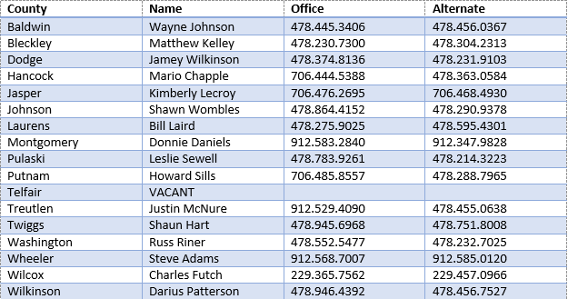
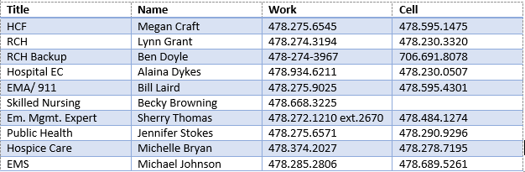
Region H Leadership EMA contacts
Region H Healthcare Coalition
Notes:
How presentation will benefit audience: Adult learners are more interested in a subject if they know how or why it is important to them.
Presenter’s level of expertise in the subject: Briefly state your credentials in this area, or explain why participants should listen to you.

Slide 15
Next Coalition Meeting
  Thursday, August 28, 2025
    OFTC, YKK room 10:00a-1:00p (hopefully, if funding freeze isn’t lifted it will be virtual)
Region H Healthcare Coalition
Notes:
How presentation will benefit audience: Adult learners are more interested in a subject if they know how or why it is important to them.
Presenter’s level of expertise in the subject: Briefly state your credentials in this area, or explain why participants should listen to you.

