Slide 1
Region H Healthcare Coalition
Quarterly Meeting: May 16, 2024
OFTC, Dubose Porter Center
9:00a-1:00p

Slide 2
Updates
EMA
EMS
Epidemiology
Public Health
Hospital
GPFL
LTC
State Partners
Region H Healthcare Coalition
Notes:
How presentation will benefit audience: Adult learners are more interested in a subject if they know how or why it is important to them.
Presenter’s level of expertise in the subject: Briefly state your credentials in this area, or explain why participants should listen to you.

Slide 3
Hurricane Season Update
NWS Weather briefing on upcoming hurricane season
Region H Healthcare Coalition
Notes:
How presentation will benefit audience: Adult learners are more interested in a subject if they know how or why it is important to them.
Presenter’s level of expertise in the subject: Briefly state your credentials in this area, or explain why participants should listen to you.

Slide 4
EMAG Report outs
Anyone who attended EMAG briefly share some of the sessions that you attended, what stood out to you, and what did you take away from the conference!
Region H Healthcare Coalition
Notes:
How presentation will benefit audience: Adult learners are more interested in a subject if they know how or why it is important to them.
Presenter’s level of expertise in the subject: Briefly state your credentials in this area, or explain why participants should listen to you.

Slide 5
Coalition business
We have spent down all our carryover and fiscal year budgets and will be starting fresh for the new grant cycle on July 1st.
This year the focus was Chemical. All PAPRS and DECON go Kits were ordered and are in our storage for all Hospital partners to pick up. EMS some kits are available for you as well! Please set up a time with me to pick up.
Region H Healthcare Coalition
Notes:
How presentation will benefit audience: Adult learners are more interested in a subject if they know how or why it is important to them.
Presenter’s level of expertise in the subject: Briefly state your credentials in this area, or explain why participants should listen to you.

Slide 6
Coalition business
We currently still do not have the guidance yet for next year. July 1 starts a new 5 year grant cycle and will run from July 1, 2024-June 30, 2029.
Some of the topics that will be our focus: Extended Downtime, Patient Placement, Cyber Security, Resource Management, Health Care Workforce Support and more.
We will still have our annual MRSE, annual Table Top Exercises, and biannual communication drills.
Region H Healthcare Coalition
Notes:
How presentation will benefit audience: Adult learners are more interested in a subject if they know how or why it is important to them.
Presenter’s level of expertise in the subject: Briefly state your credentials in this area, or explain why participants should listen to you.

Slide 7
Conferences/Meetings/Exercises/Trainings
EVENT DATES LOCATIONS SIGN UP
Coalition Meeting May 16, 2024 OFTC Survey link via gmail
ICS 400 May 16-17, 2024 OFTC See Megan CANCELED
Coalition Meeting August 22, 2024 OFTC Survey link via gmail
Coalition Meeting November 21, 2024 OFTC Survey link via gmail
NHCPC December 10-12, 2024 Orlando, FL Coalition leadership
Coalition Meeting February 13, 2025 OFTC Survey link via gmail
Hurricane Conference April 7, 2025 Savannah, GA Coalition leadership
EMAG April 8-10, 2025 Jekyll Island, GA See Megan (25 spots)
Preparedness Summit April 29-May 2, 2025 San Antonio, Texas Coalition leadership
Coalition Meeting May 22, 2025 OFTC Survey link via gmail
Region H Healthcare Coalition
Notes:
How presentation will benefit audience: Adult learners are more interested in a subject if they know how or why it is important to them.
Presenter’s level of expertise in the subject: Briefly state your credentials in this area, or explain why participants should listen to you.

Slide 8
Region H Information & Where to Find it
Region H Website: www.garegionhcoalition.com
All information can also be found on GHA911: ghc911.org
If you haven’t already, please sign up as a new user. This is the new website for GHA911. Even if you had a log in on the old website you must create a new one here.
Steps: GHC911.org → Sign Up→ Enter all information→ Myself or Mallory will approve you.
Once you are approved you can find everything on here under the File Manager tab-> Regional Coalitions -> Region H. From plans, trainings, exercises, and all Coalition meeting minutes and documents.
Region H Healthcare Coalition
Notes:
How presentation will benefit audience: Adult learners are more interested in a subject if they know how or why it is important to them.
Presenter’s level of expertise in the subject: Briefly state your credentials in this area, or explain why participants should listen to you.

Slide 9
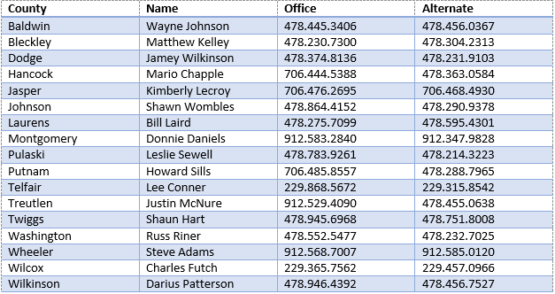
Region H Leadership EMA contacts
Region H Healthcare Coalition
Notes:
How presentation will benefit audience: Adult learners are more interested in a subject if they know how or why it is important to them.
Presenter’s level of expertise in the subject: Briefly state your credentials in this area, or explain why participants should listen to you.

Slide 10
Next Coalition Meeting
Thursday, August 22, 2024
In person 10:00a-1:00p
Region H Healthcare Coalition
Notes:
How presentation will benefit audience: Adult learners are more interested in a subject if they know how or why it is important to them.
Presenter’s level of expertise in the subject: Briefly state your credentials in this area, or explain why participants should listen to you.

