Slide 1

Region H
Healthcare Coalition
Quarterly Meeting: February 17, 2022
WebEx/Conference Call
10:00a-11:30a

Slide 2
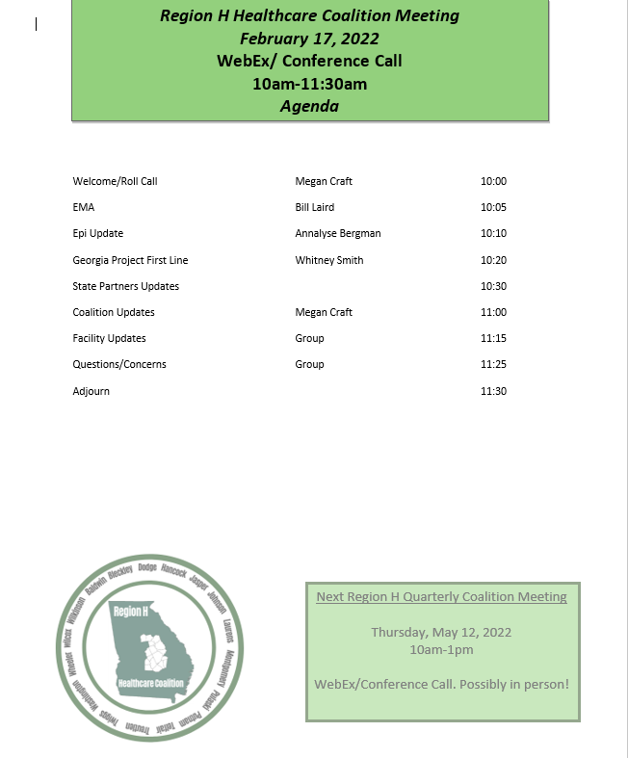

Slide 3
Updates
EMA/EMS
Epidemiology
Georgia Project First Line
State Partners
Coalition
Group/Facilities

Slide 4
2021-2022 Budget
Burn Trauma kits are waiting on one more item to arrive then they will be complete and ready to hand out. Hospitals will receive first, then EMS.
Carryover funds have been approved and we are currently spending.
Sending 5 people to Chatham Hurricane Conference? (Not been posted yet)
Sending 20 people to EMAG (2 spots left)
Sending 3 people to Preparedness Summit (all 3 spots available)
Sending 2 people to Governors Hurricane Conference (spots filled)

Slide 5
Conferences/Meetings/Exercises/Trainings
EVENT DATES LOCATIONS SIGN UP
Prep Summit April 4-7 Atlanta, GA Let me know!
EMAG April 13-15 Savannah, GA Let me know!
Burn TTX April 14th EMAG-Savannah
Govs Hurricane Conf May 8-13 Palm Beach, FL
STB training TBD TBD
MRSE Postponed to 2023

Slide 6
Region H Information & Where to Find it
Region H Website: www.garegionhcoalition.com
  Will be uploading new inventory pictures soon, can find all up to date info on our website.
All information can also be found on GHA911: gha911.org
Steps: Sign on to GHA911.org → File Library → Regional Coalition Documents → Region H
You can find everything on here from plans, trainings, exercises, and all Coalition meeting minutes and documents.
District 5-1 Counties: all Vaccine Clinics, times and locations can be found on our South Central Health District Website: www.southcentralhealth.info
District 5-2 Counties: Find all information here https://northcentralhealthdistrict.org/

Slide 7
County EMA Contacts
Baldwin: Wayne Johnson (o): 478.445.3406
Bleckley: Matthew Kelley (o): 478.230.7300
Dodge: Jamey Wilkinson(o): 478.231.9103
Hancock: Mario Chapple (o): 706.444.5388
Jasper: Brian Burgamy (o) 706.468.4930
Johnson: Shawn Wombles (o): 478.864.9759
Laurens: Bill Laird (o): 478.595.4301
Montgomery: Donnie Daniels (o): 912.583.2363
Pulaski: Leslie Sewell (o): 478.783.9261
Putnam: Howard Sills (o): 706.485.8557
Telfair: Lee Conner (o): 229.868.5672
Treutlen: Josh Love (o): 912.529.4090
Twiggs: Jack Wood (o): 478.945.6968
Washington: Russ Riner (o): 478.552.5477
Wheeler: Steve Adams (o): 912.568.7007
Wilcox: Larry Brown (o): 229.467.3203
Wilkinson: Emma Bacon (o): 478.946.2236

Slide 8
Next Coalition Meeting
Thursday, May 12, 2022
Webex/Conference call. Possible in person!
10:00a-1:00p

