Slide 1
Region H Healthcare Coalition
Quarterly Meeting: February 15, 2024
OFTC, Dubose Porter Center
9:00a-1:00p

Slide 2
Updates
EMA
EMS
Epidemiology
Public Health
Hospital
GPFL
LTC
State Partners
Region H Healthcare Coalition
Notes:
How presentation will benefit audience: Adult learners are more interested in a subject if they know how or why it is important to them.
Presenter’s level of expertise in the subject: Briefly state your credentials in this area, or explain why participants should listen to you.

Slide 3
Chemical/Radiation Surge TTX
Module 1: Initial Notification, Response & Receipt of Initial Victims
20-minute discussion
10-minute report out
Region H Healthcare Coalition
Notes:
How presentation will benefit audience: Adult learners are more interested in a subject if they know how or why it is important to them.
Presenter’s level of expertise in the subject: Briefly state your credentials in this area, or explain why participants should listen to you.

Slide 4
Chemical/Radiation Surge TTX
Module 2: Community Coordination/Collaboration, Remaining Patients
20-minute discussion
10-minute report out
Region H Healthcare Coalition
Notes:
How presentation will benefit audience: Adult learners are more interested in a subject if they know how or why it is important to them.
Presenter’s level of expertise in the subject: Briefly state your credentials in this area, or explain why participants should listen to you.

Slide 5
Chemical/Radiation Surge TTX
Module 3: Ongoing Healthcare Coordination & Recovery
25-minute discussion
10-minute report out
Region H Healthcare Coalition
Notes:
How presentation will benefit audience: Adult learners are more interested in a subject if they know how or why it is important to them.
Presenter’s level of expertise in the subject: Briefly state your credentials in this area, or explain why participants should listen to you.

Slide 6
Participant Feedback
Wrap Up
Hot wash & Discussion

Slide 7
Coalition business
We received our carryover budget earlier this month and have spent it on Portable AC/Heating Units. No carryover will happen next year because it is the end of the grant cycle.
This year the focus is Chemical. DECON kits (and training) for hospitals will be the major project to tie in the Radiation and Chemical projects.
All PAPRS and DECON go Kits were ordered and are in our storage for all Hospital partners to pick up. EMS some kits are available for you as well! Please set up a time with me to pick up.
Region H Healthcare Coalition
Notes:
How presentation will benefit audience: Adult learners are more interested in a subject if they know how or why it is important to them.
Presenter’s level of expertise in the subject: Briefly state your credentials in this area, or explain why participants should listen to you.

Slide 8
Conferences/Meetings/Exercises/Trainings
EVENT DATES LOCATIONS SIGN UP
Coalition Mtg/TTX February 15, 2024 OFTC Survey Monkey
MRSE FPM March 20, 2024 WebEx Hospitals/EMS
Prep Summit March 25-29, 2024 Columbus Ohio Coalition leadership
Hurricane Conf April 16, 2024 Savannah, GA Coalition Leadership
EMAG April 17-19, 2024 Savannah, GA 25 spots- already filled
MRSE April 9, 2024 Hospitals See Megan
Coalition Meeting May 16, 2024 OFTC Survey Monkey
ICS 400 TBD OFTC See Megan
Region H Healthcare Coalition
Notes:
How presentation will benefit audience: Adult learners are more interested in a subject if they know how or why it is important to them.
Presenter’s level of expertise in the subject: Briefly state your credentials in this area, or explain why participants should listen to you.

Slide 9
Region H Information & Where to Find it
Region H Website: www.garegionhcoalition.com
All information can also be found on GHA911: ghc911.org
If you haven’t already, please sign up as a new user. This is the new website for GHA911. Even if you had a log in on the old website you must create a new one here.
Steps: GHC911.org → Sign Up→ Enter all information→ Myself or Mallory will approve you.
Once you are approved you can find everything on here under the File Manager tab-> Regional Coalitions -> Region H. From plans, trainings, exercises, and all Coalition meeting minutes and documents.
Region H Healthcare Coalition
Notes:
How presentation will benefit audience: Adult learners are more interested in a subject if they know how or why it is important to them.
Presenter’s level of expertise in the subject: Briefly state your credentials in this area, or explain why participants should listen to you.

Slide 10
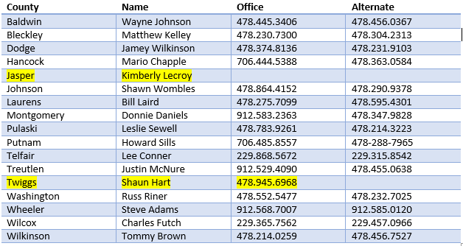
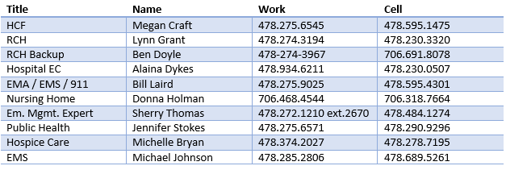
Region H Leadership EMA contacts
Region H Healthcare Coalition
Notes:
How presentation will benefit audience: Adult learners are more interested in a subject if they know how or why it is important to them.
Presenter’s level of expertise in the subject: Briefly state your credentials in this area, or explain why participants should listen to you.

Slide 11
Next Coalition Meeting
Thursday, May 16, 2024
In person 10:00a-1:00p
Region H Healthcare Coalition
Notes:
How presentation will benefit audience: Adult learners are more interested in a subject if they know how or why it is important to them.
Presenter’s level of expertise in the subject: Briefly state your credentials in this area, or explain why participants should listen to you.

