Slide 1

Region H
Healthcare Coalition
Quarterly Meeting: February 13, 2025
Virtual via WebEx
10:00-11:30

Slide 2

Updates
EMA
Region H Healthcare Coalition
Notes:
How presentation will benefit audience: Adult learners are more interested in a subject if they know how or why it is important to them.
Presenter’s level of expertise in the subject: Briefly state your credentials in this area, or explain why participants should listen to you.

Slide 3
Updates
EMA
EMS
Region H Healthcare Coalition
Notes:
How presentation will benefit audience: Adult learners are more interested in a subject if they know how or why it is important to them.
Presenter’s level of expertise in the subject: Briefly state your credentials in this area, or explain why participants should listen to you.

Slide 4
Updates
EMA
EMS
Public Health
Region H Healthcare Coalition
Notes:
How presentation will benefit audience: Adult learners are more interested in a subject if they know how or why it is important to them.
Presenter’s level of expertise in the subject: Briefly state your credentials in this area, or explain why participants should listen to you.

Slide 5
Updates
EMA
EMS
Public Health
Epidemiology
Region H Healthcare Coalition
Notes:
How presentation will benefit audience: Adult learners are more interested in a subject if they know how or why it is important to them.
Presenter’s level of expertise in the subject: Briefly state your credentials in this area, or explain why participants should listen to you.

Slide 6
Updates
EMA
EMS
Public Health
Epidemiology
Hospital
Region H Healthcare Coalition
Notes:
How presentation will benefit audience: Adult learners are more interested in a subject if they know how or why it is important to them.
Presenter’s level of expertise in the subject: Briefly state your credentials in this area, or explain why participants should listen to you.

Slide 7
Updates
EMA
EMS
Public Health
Epidemiology
Hospital
GPFL
Region H Healthcare Coalition
Notes:
How presentation will benefit audience: Adult learners are more interested in a subject if they know how or why it is important to them.
Presenter’s level of expertise in the subject: Briefly state your credentials in this area, or explain why participants should listen to you.

Slide 8
Updates
EMA
EMS
Public Health
Epidemiology
Hospital
GPFL
LTC
Region H Healthcare Coalition
Notes:
How presentation will benefit audience: Adult learners are more interested in a subject if they know how or why it is important to them.
Presenter’s level of expertise in the subject: Briefly state your credentials in this area, or explain why participants should listen to you.

Slide 9
Updates
EMA
EMS
Public Health
Epidemiology
Hospital
GPFL
LTC
State Partners
Region H Healthcare Coalition
Notes:
How presentation will benefit audience: Adult learners are more interested in a subject if they know how or why it is important to them.
Presenter’s level of expertise in the subject: Briefly state your credentials in this area, or explain why participants should listen to you.

Slide 10
Real World Events
Report out from any/all Region H members who were affected by snowstorm or any power outages, etc.
And any of those that received resources from us- tell us how the process was, and what can be improved.
Region H Healthcare Coalition
Notes:
How presentation will benefit audience: Adult learners are more interested in a subject if they know how or why it is important to them.
Presenter’s level of expertise in the subject: Briefly state your credentials in this area, or explain why participants should listen to you.

Slide 11
Coalition business
July 1 started the new 5 year grant cycle and will run from July 1, 2024-June 30, 2029.
Some of the topics that will be our focus: Extended Downtime, Patient Placement, Cyber Security, Resource Management, Health Care Workforce Support and more. This year will consist of a lot of plans and Coalition Assessments. Be on the lookout for multiple surveys.
We will still have our annual MRSE and biannual communication drills.
Region H Healthcare Coalition
Notes:
How presentation will benefit audience: Adult learners are more interested in a subject if they know how or why it is important to them.
Presenter’s level of expertise in the subject: Briefly state your credentials in this area, or explain why participants should listen to you.

Slide 12
Coalition Budget
We received funding at the end of September started spending then unfortunately we are currently on a spending freeze. We don’t have any details on when we can spend again but we are hopeful it will be soon. If not, we will update everyone on what we find out about the budget.
If you want to travel to EMAG we have 1 spot available unless the funding freeze does not get lifted, then we will have to cancel.
Region H Healthcare Coalition
Notes:
How presentation will benefit audience: Adult learners are more interested in a subject if they know how or why it is important to them.
Presenter’s level of expertise in the subject: Briefly state your credentials in this area, or explain why participants should listen to you.

Slide 13
Conferences/Meetings/Exercises/Trainings
EVENT DATES LOCATIONS SIGN UP
Coalition Mtg February 13, 2025 VIRTUAL* Survey Monkey
EMAG April 8-11, 2025 Jekyll Island, GA 25 spots
Communication Drill May 20, 2025 Everbridge
Coalition Meeting May 22, 2025 OFTC Survey Monkey
MRSE March 27, 2025 Hospitals
Region H Healthcare Coalition
Notes:
How presentation will benefit audience: Adult learners are more interested in a subject if they know how or why it is important to them.
Presenter’s level of expertise in the subject: Briefly state your credentials in this area, or explain why participants should listen to you.

Slide 14
Region H Information & Where to Find it
Region H Website: www.garegionhcoalition.com
All information can also be found on www.GHC911.org
If you haven’t already, please sign up as a new user. This is the website for GHA911. Even if you had a log in on the old website you must create a new one.
Steps: GHC911.org → Sign Up→ Enter all information → we will approve you.
  Once you are approved you can find everything on here under the File Manager tab-> Regional Coalitions -> Region H. You can find everything from plans, trainings, exercises, and all Coalition meeting minutes and documents.
Region H Healthcare Coalition
Notes:
How presentation will benefit audience: Adult learners are more interested in a subject if they know how or why it is important to them.
Presenter’s level of expertise in the subject: Briefly state your credentials in this area, or explain why participants should listen to you.

Slide 15
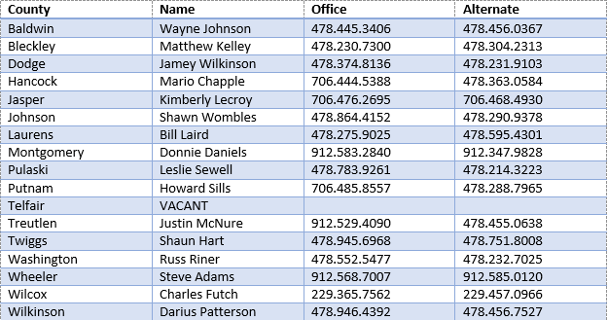
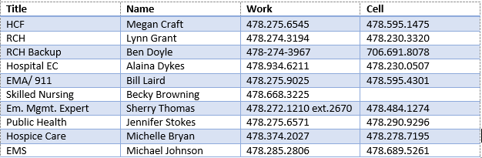
Region H Leadership EMA contacts
Region H Healthcare Coalition
Notes:
How presentation will benefit audience: Adult learners are more interested in a subject if they know how or why it is important to them.
Presenter’s level of expertise in the subject: Briefly state your credentials in this area, or explain why participants should listen to you.

Slide 16
Next Coalition Meeting
  Thursday, May 22, 2025
    OFTC, YKK room 10:00a-1:00p (hopefully, if funding freeze isn’t lifted it will be virtual)
Region H Healthcare Coalition
Notes:
How presentation will benefit audience: Adult learners are more interested in a subject if they know how or why it is important to them.
Presenter’s level of expertise in the subject: Briefly state your credentials in this area, or explain why participants should listen to you.

